Slide 1

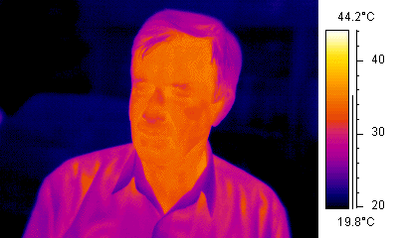
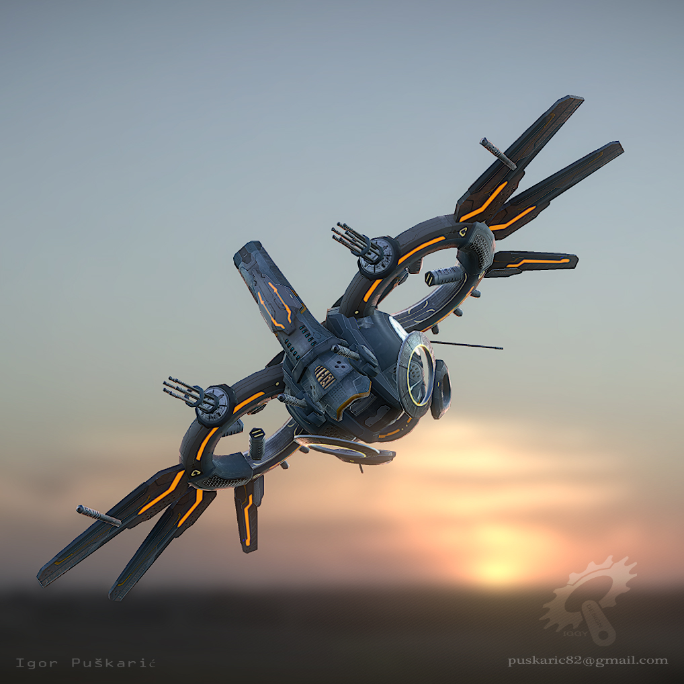
Design and Development of Aerial Thermal Imaging Drone
Guided by: Ms. Gauri borkhade
Simran singh
Saloni lohar
Samruddha adsule
Sonal Kamble
This Photo by Unknown Author is licensed under CC BY-ND

Slide 2
ABSTRACT
As it can be seen around the world, the pandemic has led to huge loss of human life world-wide and it presents unprecedented challenges to people’s health, food systems and the working class.
Situations have been such that millions of people have begun to face poverty and large numbers are reported undernourished.
Viruses such as COVID-19, H1N1, MERS, Spanish flu etc. can put lives in danger even after this widespread as they travel through the air, also there is lack of awareness and rapid outpour.
It has been observed all over the world that how challenging it could be to detect and treat the infected in large crowds.
Detection using infrared guns/ thermometers is been carried as one of the major symptoms is fever but those methods do involve physical contact, putting the detector’s life at risk.

Slide 3
The Aerial Thermal Imaging Drone can be one of the best ways to detect the infected without any physical contact/ interaction.
It is an IoT based system that combines a drone and a thermal camera that would transfer the scanned data based on temperature to a smartphone application.

Slide 4
Table of Contents
Introduction…
Aim
Objectives
Scope of the project
Methodology used
Description of the existing system
Disadvantages of the existing system
Proposed system

Slide 5
Continued…
Advantages of Proposed System
Component Requirements
Flowchart
Different DFD levels
Implementation
Additional features
Future Modifications
Conclusion….

Slide 6
Introduction…
This IoT based Thermal imaging system has been provided with different temperature levels specifying the normal and harmful temperatures.
Primary aim of this project is to detect the bodies with higher or lower than the normal body temperature i.e. 37ºC to 37.2ºC without any physical contact/ interaction.
This system can also be used for tracking purposes over inhabited areas, war zones or to find missing people under collapsed buildings or landslides.
This project combines the Thermal Camera as for rendering the infrared light, as it is a non-contact device it detects the infrared energy and it converts it into a Visual Image.

Slide 7
A small screen attached to it will display the readings in real time. If someone close to the harmful temperature is detected, a warning will pop on the observer’s screen.
Real time detection of the infected would help authorities to find out patients by continuous monitoring of the screening image.

Slide 8
Aim:
To design a system capable to detect the spreaders without physical screening or human interaction.
Objectives:
Read data from the MLX90640 thermal camera sensor.
Convert the data to temperature readings.
Generate thermal videos based on the readings.
To transmit data to ground station with redundant mediums.
To identify the detected person via image processing, cross-referencing images from thermal and action camera (mounted on drone).

Slide 9
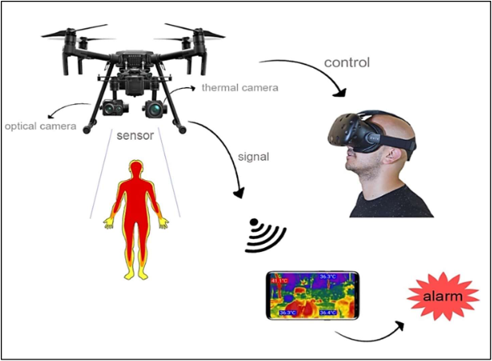
Scope of the project
An innovative real-time early detection of coronavirus and monitoring system using an Unmanned Aerial Vehicle (UAV) or drone integrated with thermal camera has been developed.
The proposed system can detect ground surface temperatures from a height above the ground.

Slide 10
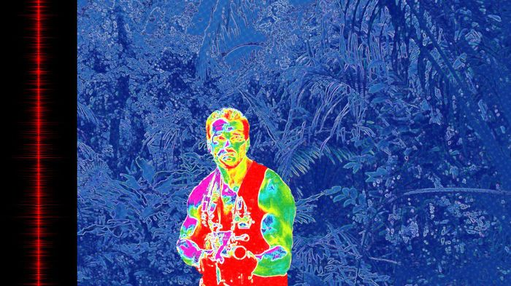
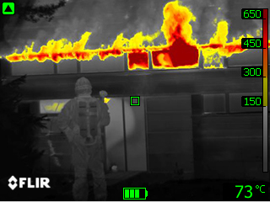
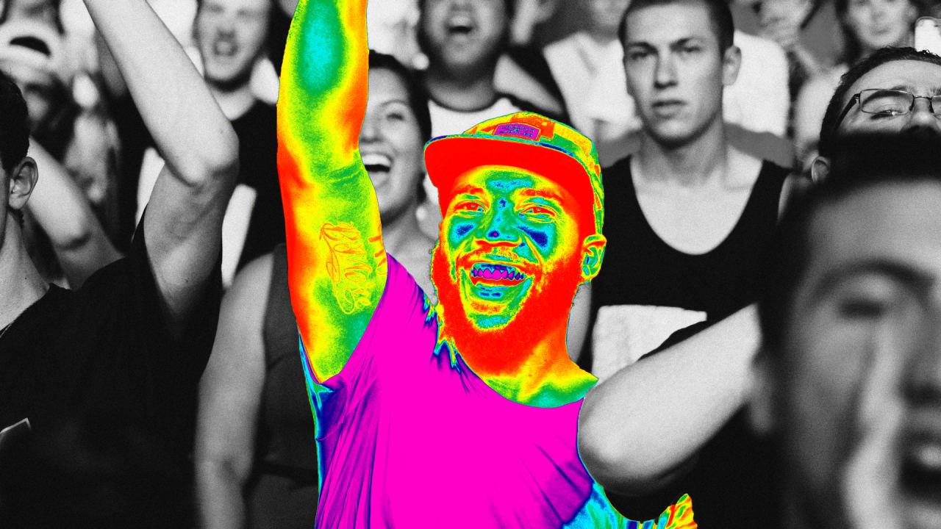
Intrusion/ Movement Detection
Identifying the infected considering high body temperature
Safety and convenience application

Slide 11
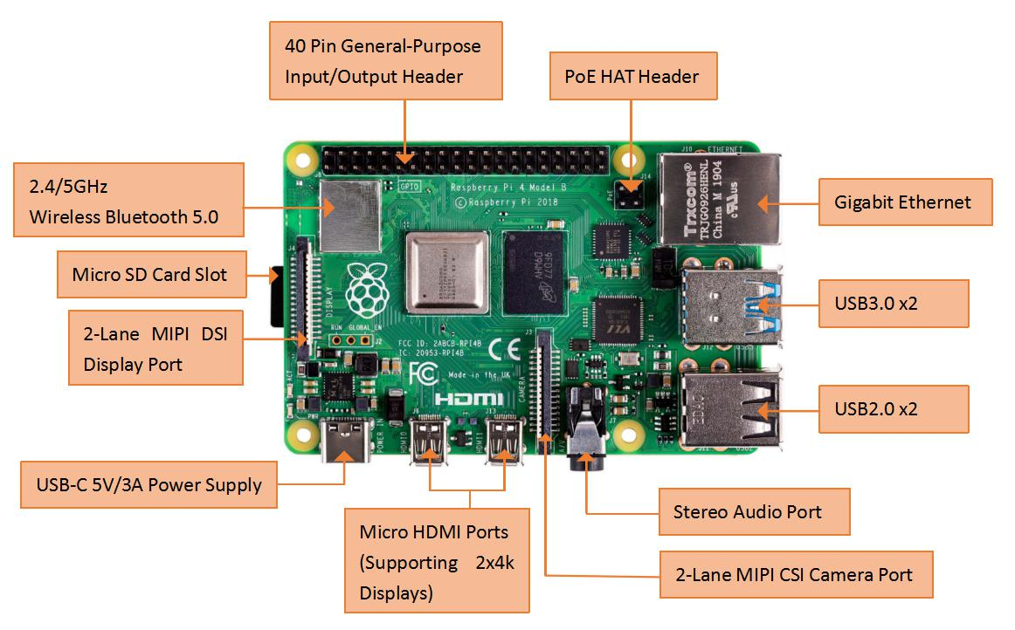
Methodology
Raspberry Pi 4 :

Slide 12
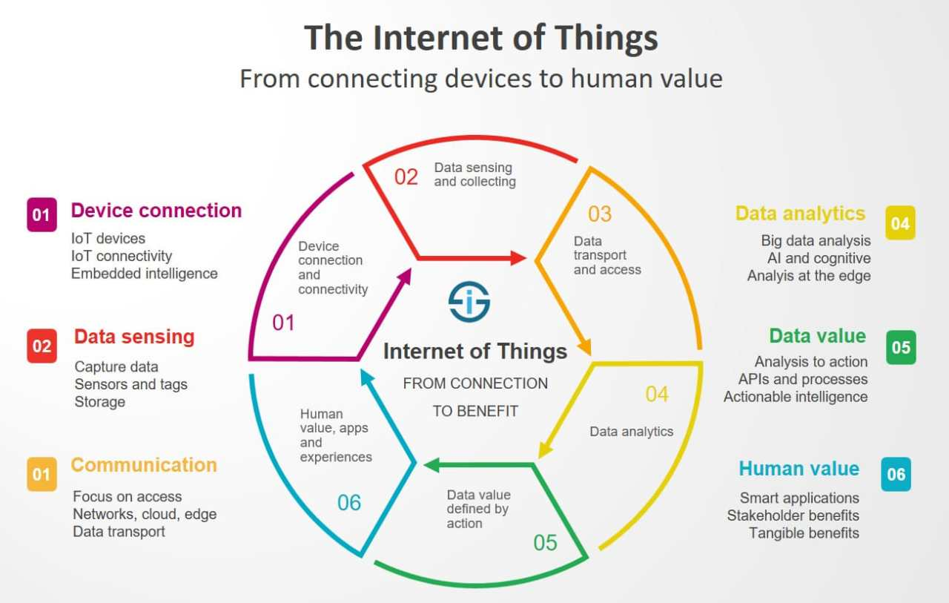
Internet of Things (IoT) :

Slide 13
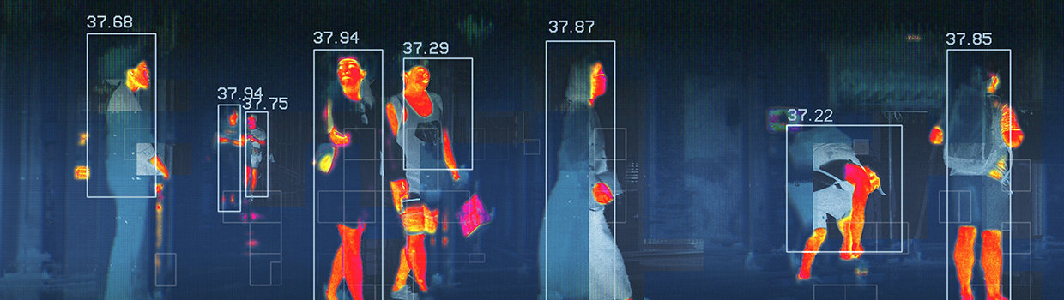
Thermal Camera Image capturing:
A Thermal Imaging Camera (TIC) could be like the thermographic camera used in firefighting.
By rendering infrared light, such cameras allow firefighters to ascertain areas of warmth through smoke, darkness, or heat-permeable barriers.
A thermal camera is a non-contact device that detects infrared energy (heat) and converts it into a visual image (Thermal cameras detect temperature by recognizing and capturing different levels of infrared).
This light is invisible to the human eye, but often felt as heat if the intensity is high enough.

Slide 14
Algorithm working steps :
Read data from the MLX90640 thermal camera sensor.
Convert the data to temperature readings.
Generate thermal videos based on the readings.
Detect the person gender
To transmit data to ground station with redundant mediums.
To identify the detected person via image processing cross-referencing images from thermal camera and action camera (mounted on drone).

Slide 15

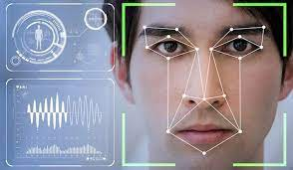
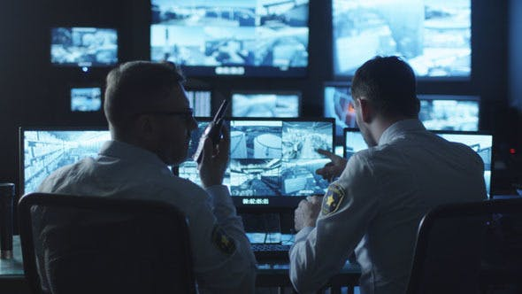
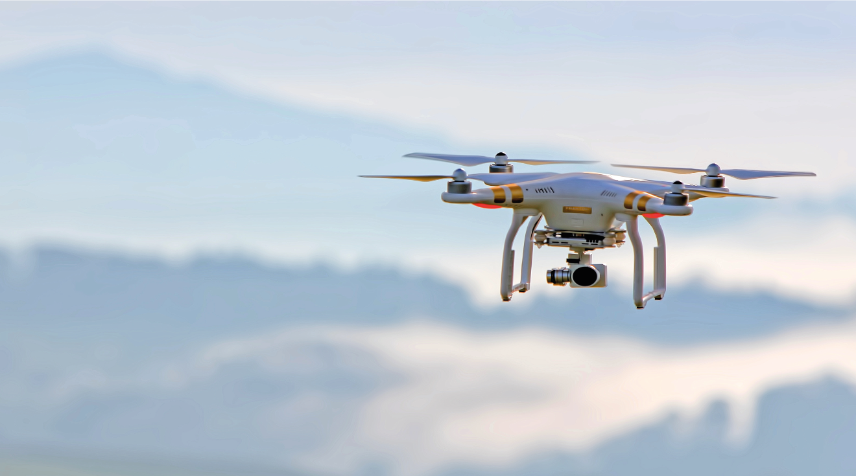

Camera Working :

Slide 16
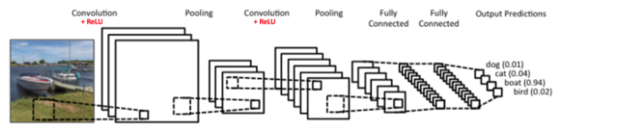
Convolutional Neural Network :

Slide 17
Preprocessing :
In the Preprocessing Part we will read the images stored in folders.
Two arrays created
Image resizing as specified
Address of the image
Array consis--ting pixel values
Folder
Python array
CV2 Python library
Pixel value of images
Numerical Python array
Conversion to…

Slide 18

Normalizing pixel values…
Pixel values
(between 0 to 255)
Dividing each pixel value by 255

Slide 19
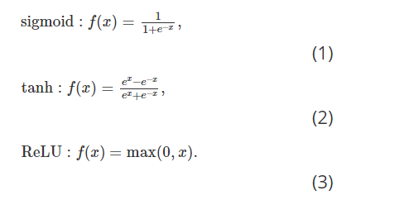
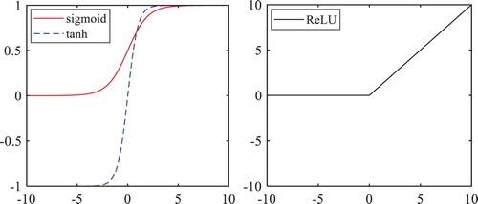
Activation Functions:
Sigmoid
Tan-h
Relu
Leaky-Relu
Softmax (Multiple Classes)
-Diagram of Activation Functions

Slide 20
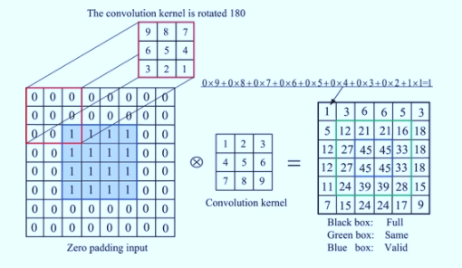
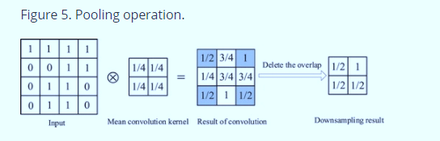
Layers and their functions:
Conv2D

Slide 21
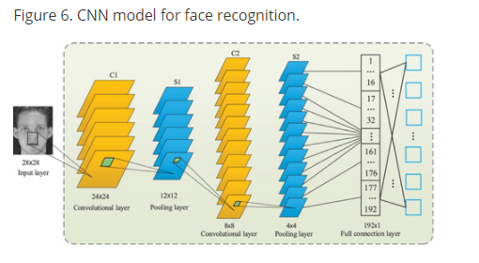
CNN model for Face Recognition:

Slide 22
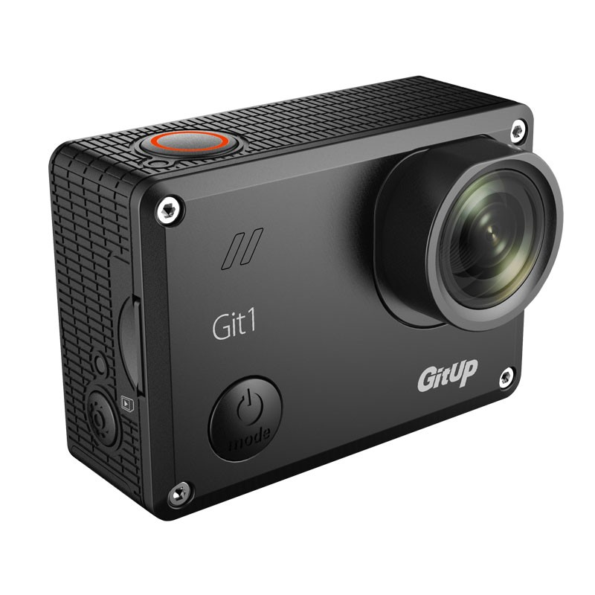
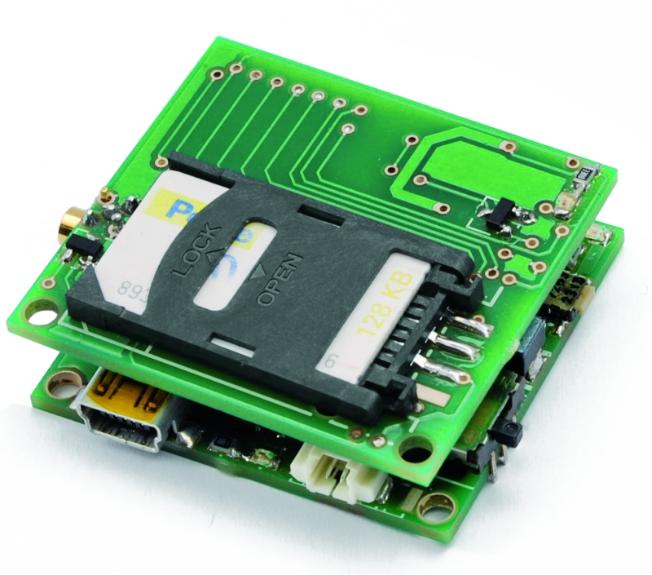
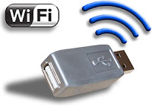
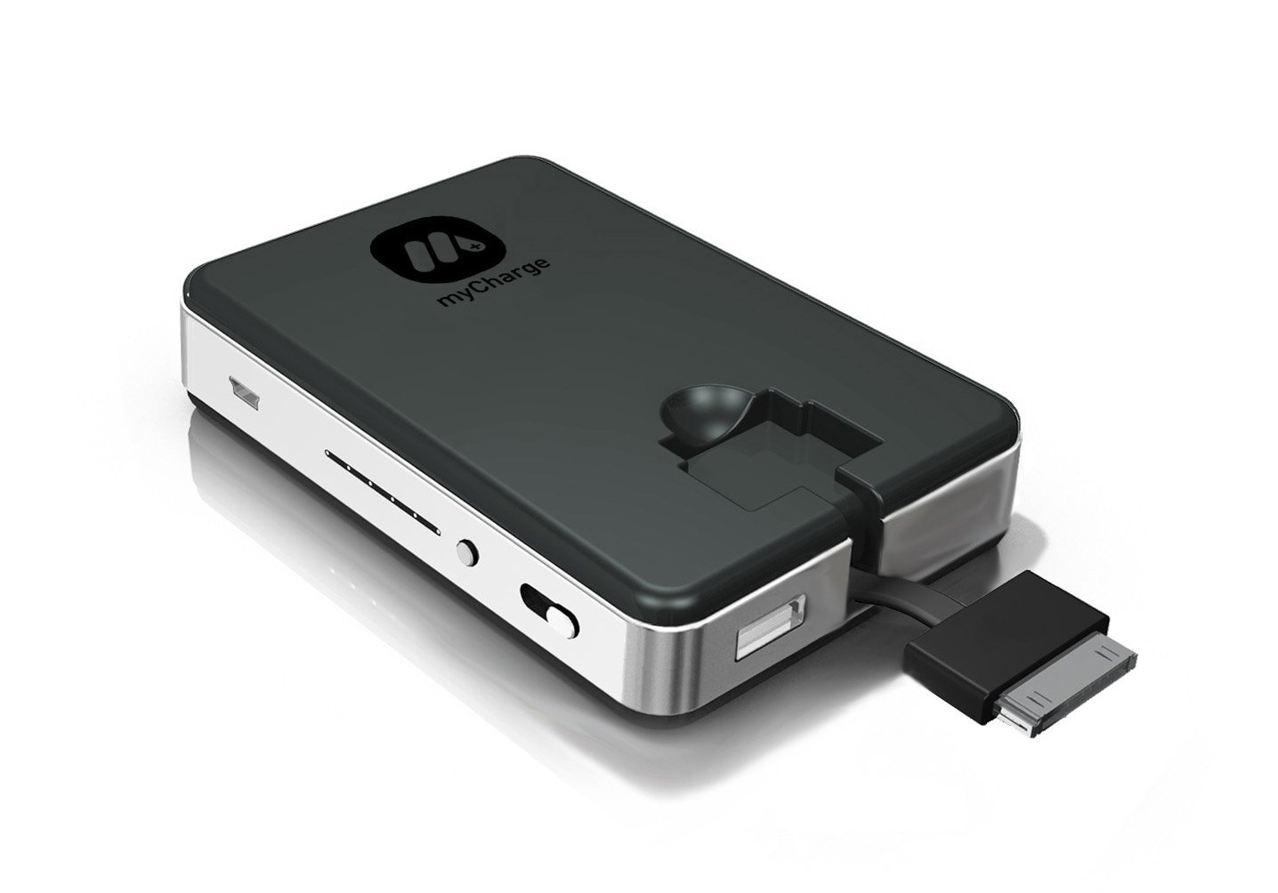
Hardware components for Drone :
Action Camera
GPS
Wi-Fi
Power bank
Software Specifications:
Pi4
Python Programming Language

Slide 23


Technologies used :
Flask:
Is a Development Server
Debugger
RESTful request dispatching
Unicode Based
Flask have google engine Compatibility

Slide 24
Existing System
In the Existing System, the thermal camera helps to rescue/find a person or detect heat related issues.
Missing or people residing near war zones can be tracked over large inhabited areas.
Leakages causing rise in temperature can also be detected using the thermal camera and drone combination.

Slide 25
Disadvantages of Existing System
They are not cost-effective.
Results displayed on screen cannot be relied upon.
Time consuming process.

Slide 26
Proposed System
In this IoT based system, Drone and the thermal camera are attached so that the camera can scan over large Crowd and segregate the data based on temperature.
Here we have combined the Thermal camera with a small screen. The screen acts as a display to show temperature in the Real time, and warn in case someone outside the range is detected.

Slide 27
Advantages of Proposed System
Cost-effective in a business protection scenario.
Can be used for military and national security purposes as well in scanning the hidden enemy.
Used in agricultural fields as well to check and analyse on irrigation issues.
Can be used in firefighting operations to detect the exact location of the people stuck.

Slide 28
Component requirements
Hardware components for Thermal Camera:
Raspberry Pi 4 Computer Model B 4GB,
Grove - Thermal Imaging Camera / IR Array MLX90640 55 degree,
Grove - 4 pin Female Jumper to Grove 4 pin Conversion Cable (5 PCs per Pack),
Raspberry Pi 4 Official micro HDMI to Standard HDMI Male Cable - 1m White,
Wall Adapter Power Supply - 5VDC 3A Type-C,
A SD Card (SanDisk Extreme Pro SD cards/Any supported).

Slide 29
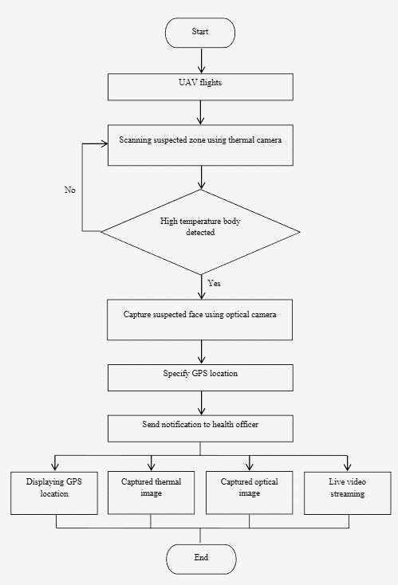
Flowchart:

Slide 30
0 Level DFD
Thermal Imaging Drone system
Request
Request
USER
SERVER
Response
Response
DATABASE

Slide 31
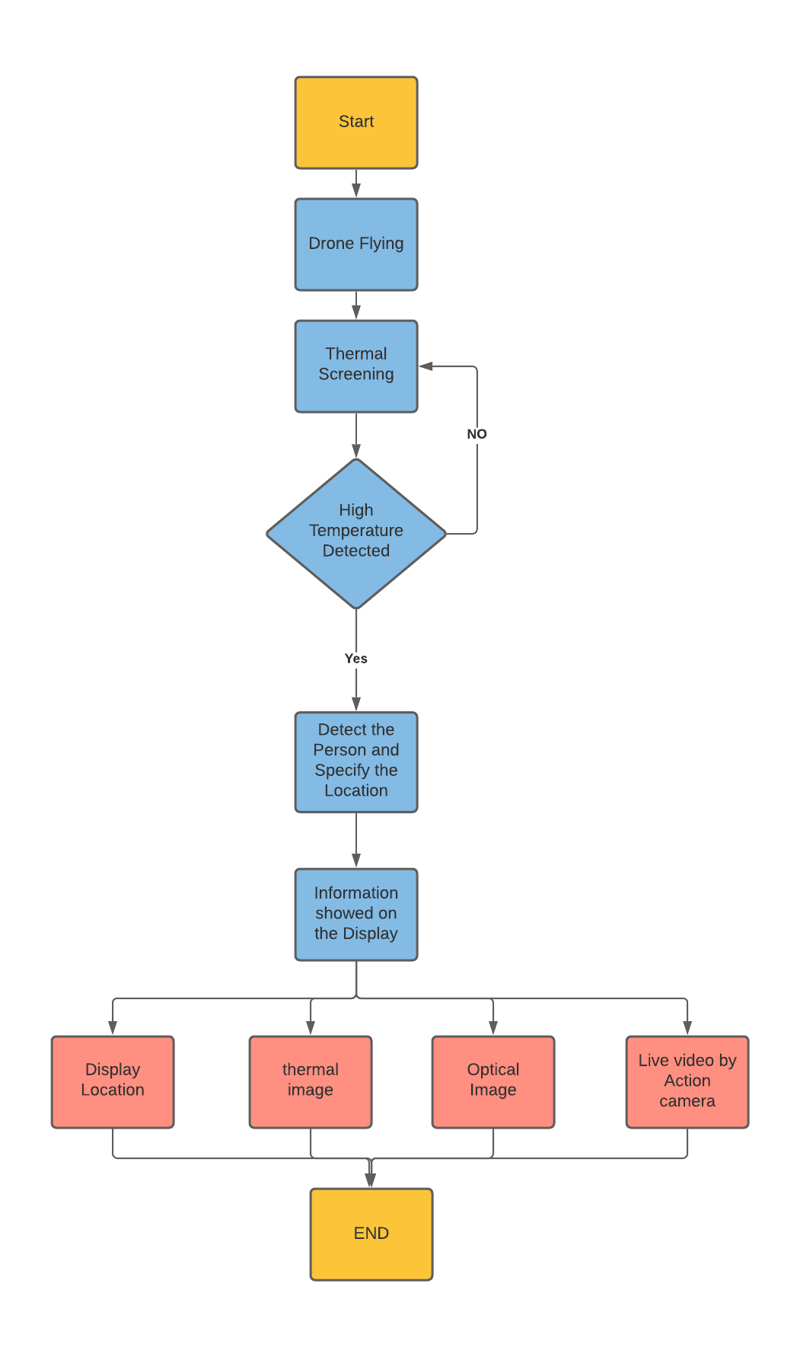
DFD 1:

Slide 32
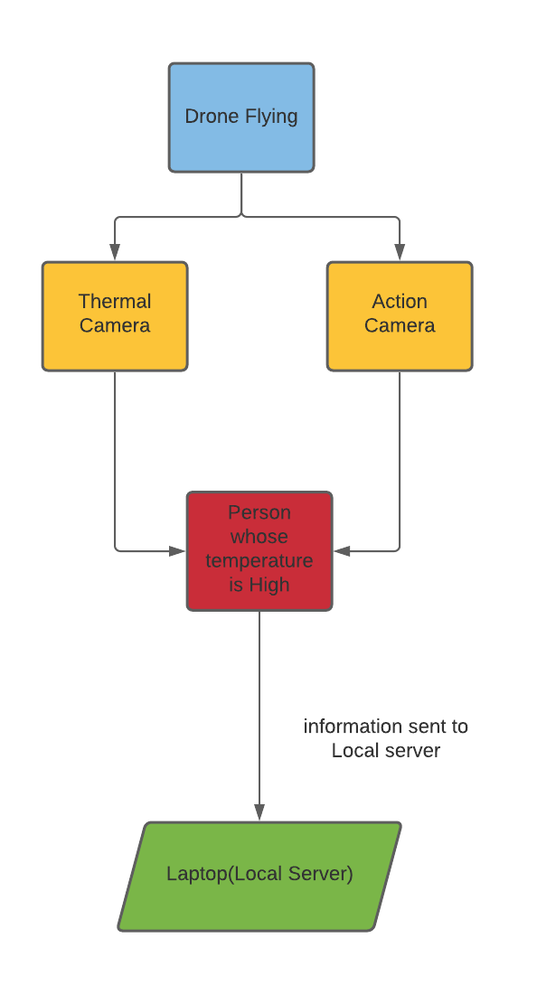
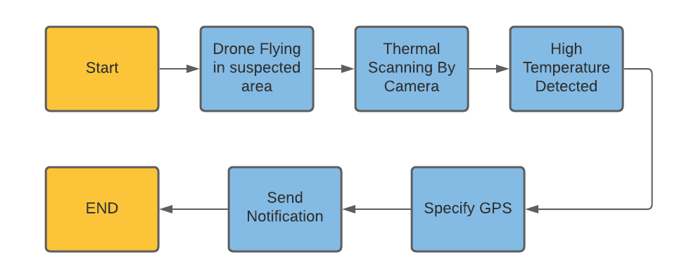

Slide 33
Future Modifications
It can be used for thermal screening to identify presence and depth at which living beings are trapped below a collapsed buildings or in a landslide calamity.
Aerial thermal imaging drone can be used to detect and identify multiple identities emitting high thermal radiation in the event of mass gathering or a crowded place in covid-19 times.
Image sensing/ identity identification using data sets.
High precisions non-contact temperature measurements.
Safety and convenience applications; fire prevention systems, etc.
Intrusion/Movement detection.
Microwave ovens.
Industrial temperature control of moving parts.
Visual IR thermometers.

Slide 34
Conclusion
An innovative real-time early detection of corona virus and monitoring system using an Unmanned Aerial Vehicle (UAV) or drone which integrated with thermal camera has been developed. The proposed system can detect ground surface temperatures from a height above the ground and send the measured data to a server to be displayed on a smartphone application. Early detection of the coronavirus symptoms will be one of the suitable ways to prevent the spreading of COVID-19.
As fever is one of the very common symptoms, a real time monitoring system with a screening factor that automatically displays the thermal image of people with higher temperature.
So the diagnosis of the screening process will be less time consuming and less human interactions that might cause the spreading of the coronavirus faster.
It can be concluded that the technology of the remote sensing and detection that presents an assortment of ways for identify, screening, and monitoring of coronavirus, give an extraordinary guarantee and potential in order to fulfil the demands from the healthcare system.

Slide 35
THANK YOU!

